Slide 1
APIs. Simplified.

Slide 2
Rapid prototyping using html5 and App services
Using Backend-as-a-Service

Slide 3
Agenda
What is Backend-as-a-Service?
Building an HTML5 App
Web-app GUI builder (jquerymobile.com using Codiqa)
Collaborative web-app IDE (jsbin.com)
Google Maps static maps API
Apigee AppServices (apigee.com/usergrid/)
Q&A

Slide 4
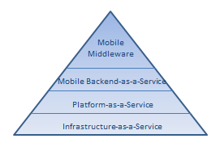
Backend-as-a-Service?
Called BaaS or MBaaS
Cloud based storage for App
RESTful API exposure
User and access management
Forrester: MOBILE BACKEND-AS-A-SERVICE: THE NEW LIGHTWEIGHT MIDDLEWARE?

Slide 5







App Services: extend your systems with modern app functions
User Management
Data Store
Simplify user management
Extend internal systems
Use locational relevance
Simplify and leverage social user interaction
Location
Developers
Activity Streams
Messaging
Social Graph
Notes:
Main Points:
Provides pre-built features as a backend service that gives developers the features that modern apps need to be successful
Script:
The best solution is to use pre-built Apigee App Services. They provide pre-built features as a backend service that gives developers the features that modern apps need to be successful. The alternative, to develop these capabilities, requires not only the initial development costs but also the costs associated ongoing maintenance and updates.
App Services get developers up and running quickly with these services available in your API. They enable you to:
Simplify user management with prebuilt registration, authentication, provisioning, reminders, and subscriptions
Extend internal systems with a schema-less data store that include pre-built application objects and can scan to meet your enterprise needs.
Use locational relevance in your Apps with proximity searches and location queries.
Connect users with activity streams that show status updates, check-ins, and user actions and comments
Provide messaging to users enabling them to message each other, and other systems
Enhance user interaction with social graphs that show where users are and their status
Background Info:
User Management
Registration
Authentication
Provisioning
Subscriptions
Upgrades
Reminders
Data Store
Schema-less data with scale
Pre-built application objects
Location
Proximity search
Location queries
Activity Streams
User actions
Comments
Check-ins
Status Updates
Questions
Messaging
Connections to CMS and blog systems
Messaging between users
Social Graph
Profile and social graph capture
Status distribution

Slide 6

Capabilities of Apigee App Services
Mobile Apps
Pattern
User Management
Messaging
Social
Graph
Datastore
Location
Analytics
Activities
➜
➜
➜
➜
➜
➜
➜
Problem
Registration
Authentication
Provisioning
Subscriptions
Upgrades
Reminders
Connections to CMS and blog systems
Messaging between users
Profile and social graph capture
Status distribution
Proximity search
Location queries
Behavior tracking and targeting
Real-time activity processing
User actions
Comments
Check-ins
Status Updates
Questions
Schema-less data with scale
Pre-built application objects
Developers
APP SERVICES

Slide 7
App Services Architecture
REST Framework (Jersey)
Account Management
Shiro Security
User Service
Group Service
Activity Service
More Services…
Service Manager
Entity Manager
Spring
Cassandra Database
APP SERVICES

Slide 8
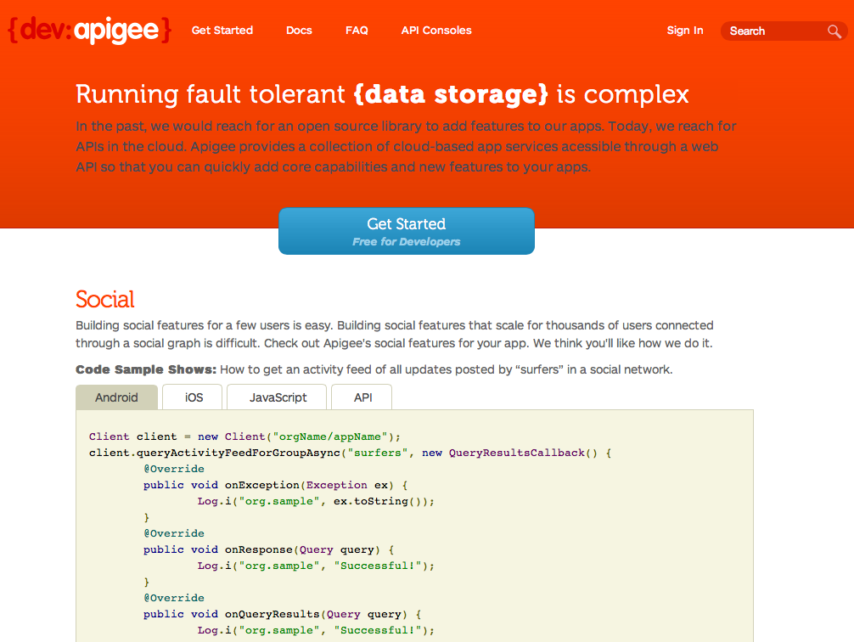
More info…
https://developers.apigee.com

Slide 9
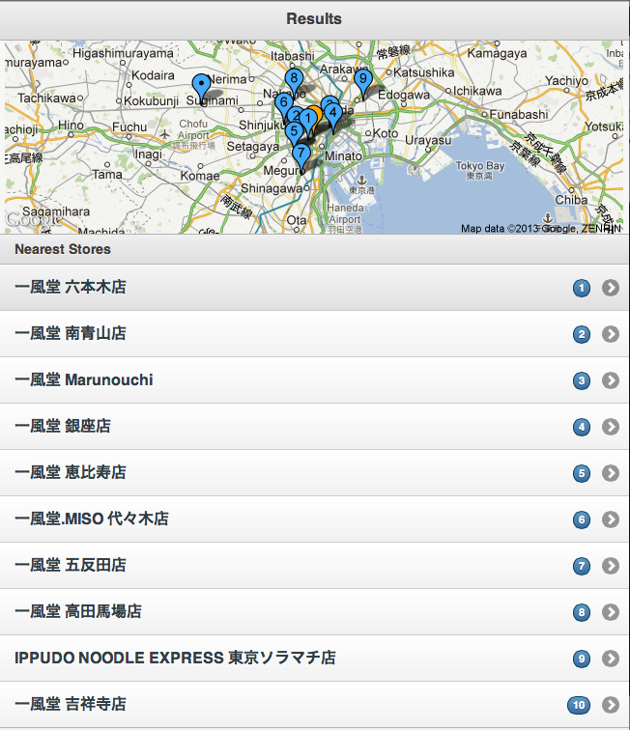
Let’s Build an HTML5 Location Finder App

Slide 10
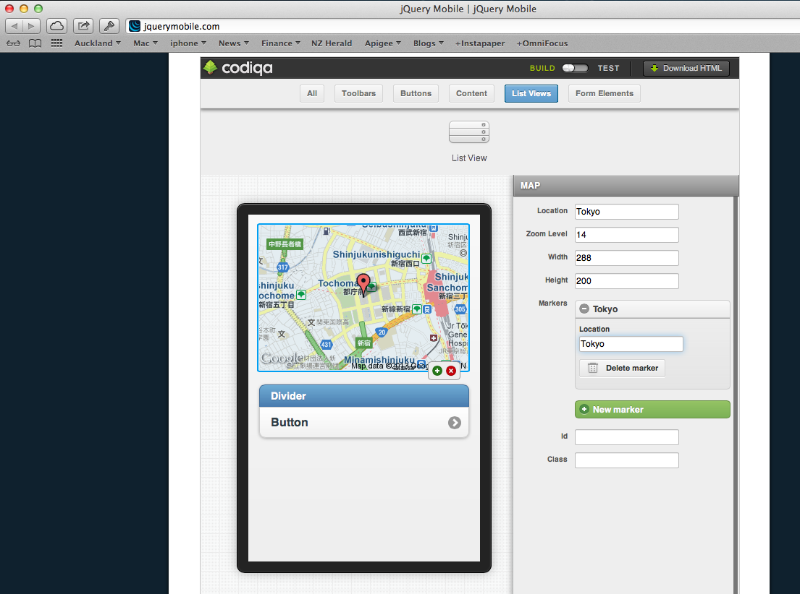
Mobile App GUI Builder
http://jquerymobile.com

Slide 11
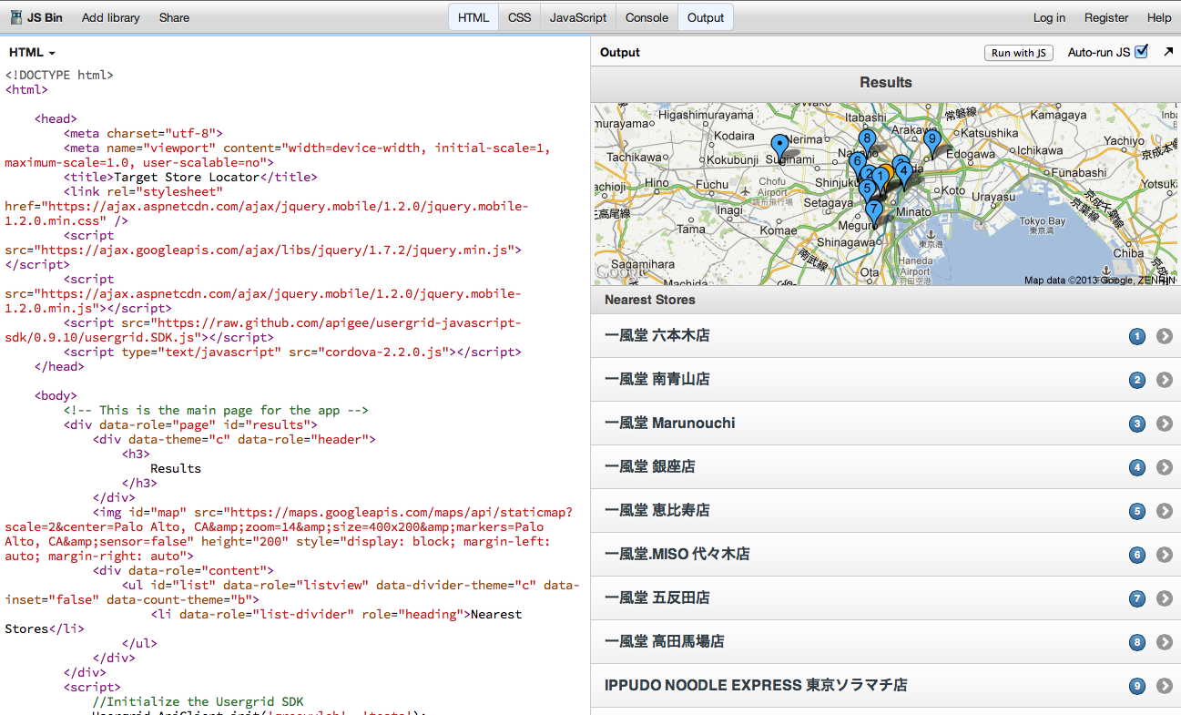
Collaborative Web-App IDE
http://jsbin.com

Slide 12
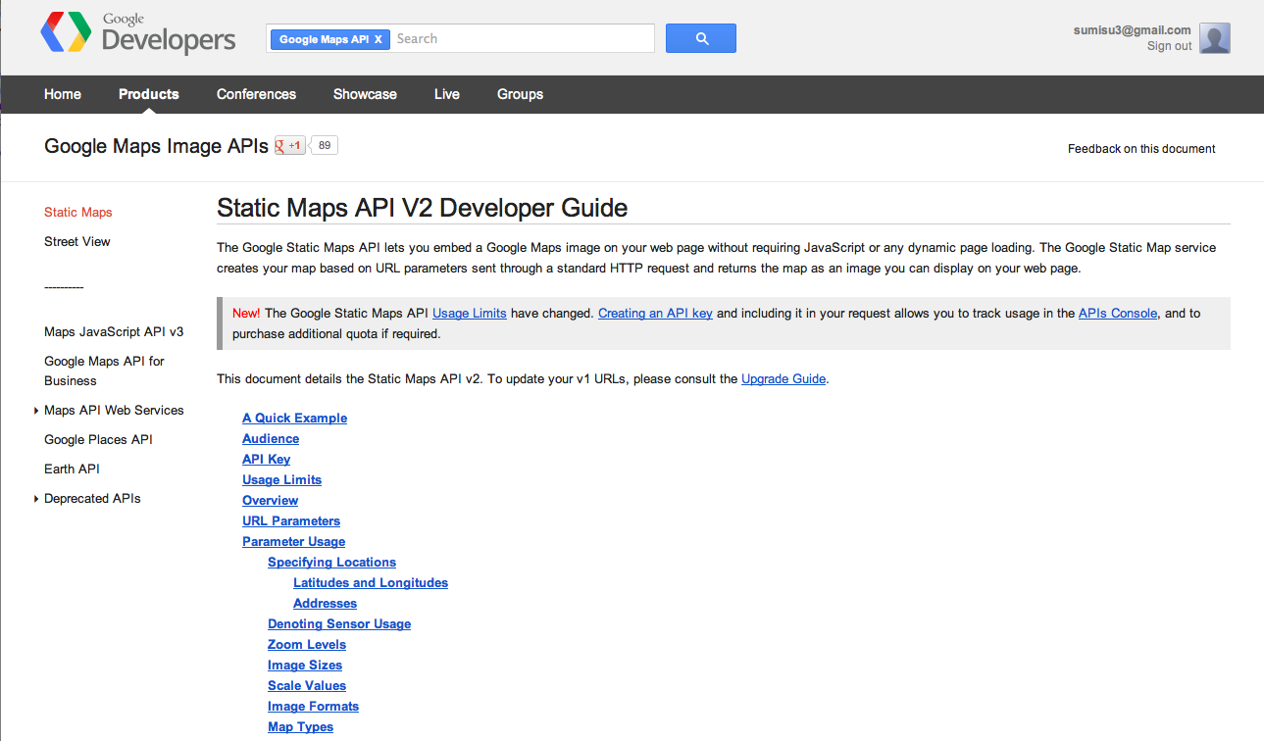
Google Maps (Static Maps) API
https://developers.google.com/maps/documentation/staticmaps

Slide 13
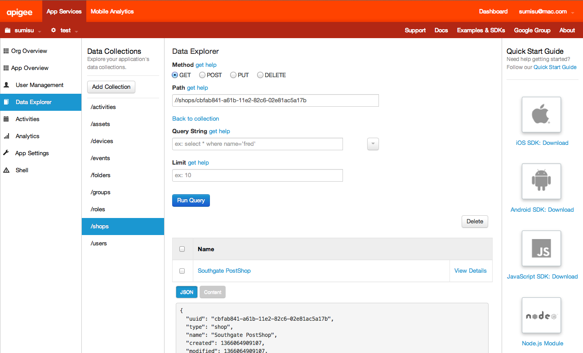
Apigee App Services

Slide 14
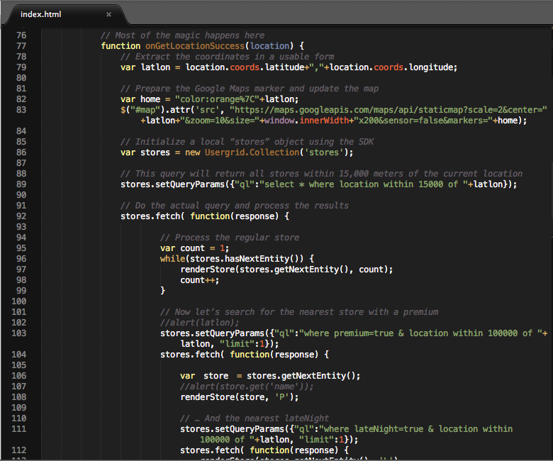
The App

Slide 15

Questions

Slide 16
Thank you.
Notes:
Apigee version 4 presentation
Version 10.8: Updates post sales meeting, still needs scripting
V 10.9: updated “the many uses of APIs” slide, logo slide, beginning scripting.
V 10.96 content complete. 8/28/12

